Slide 1


HEALTH 4 TIME
012345678900
Irán América Chavarria Monge 21550313
Ana Paulina Villegas Treviño 21550367
Jesus Alberto Jacquez Fabela 21550337
01234567890000123456789000123

Slide 2
Table of contents
01
02
03
INTRODUCTION
OBJECTIVE/GOAL
DEVELOPMENT
04
05
CONCLUSION
RESOURCES
What’s our idea?
What are we looking for?
What our idea is about.
Brief summary of our information.
Where our motivation/idea came from.

Slide 3

What’s our idea?
Quarantine affected all of us in lots of aspects, health care is one of them.
More patients = less time and storage.
We need faster processes and management.

Slide 4







Slide 5


Slide 6




For health centers…
time
012345678900
Health center
administration

Slide 7

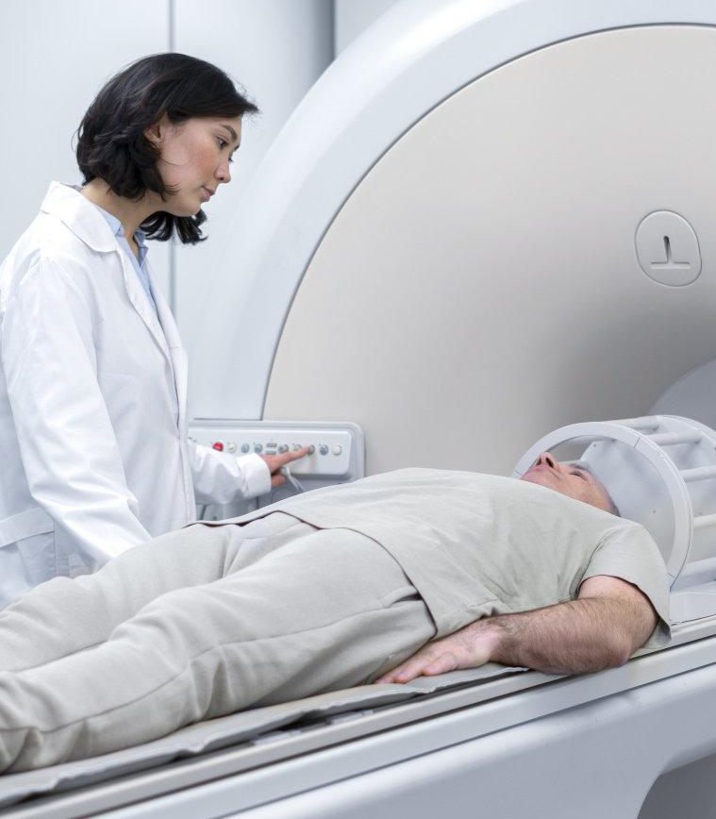

No worries, health 4 time got you…
Optimize time
optimize management
goal/objective
We need quick tools to attend patients as fast as possible.
But we also need management to organize the data we own.

Slide 8
What’s our idea about?
ORGANIZED WAY TO:
Related to the subject:
Obtain data from the patient.
Find medicines. Inventory.
Create a prescription.
Develop it in NetBeans.
Usage of space properly.
Relate everything to the concepts & topics.

Slide 9

CONCLUSION
The goal of our project is to give the best satisfaction possible to the user.
QUOTE

Slide 10
Resources
La COVID-19 afectó el funcionamiento de los servicios de salud para enfermedades no transmisibles en las Américas. (s. f.-b). OPS/OMS | Organización Panamericana de la Salud. Recuperado 9 de septiembre de 2022, de https://www.paho.org/es/noticias/17-6-2020-covid-19-afecto-funcionamiento-servicios-salud-para-enfermedades-no
La tecnología: gran aliado en tiempo de pandemia. (s. f.). Tecnológico de Monterrey. Recuperado 9 de septiembre de 2022, de https://conecta.tec.mx/es/noticias/puebla/educacion/la-tecnologia-gran-aliado-en-tiempo-de-pandemia

Slide 11
Thanks for attention
01234567890000

